Slide 1


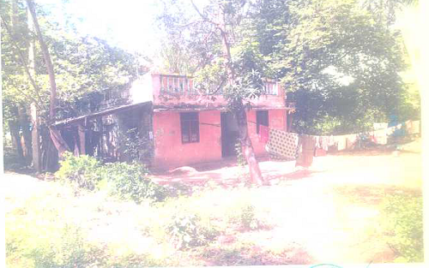
Residential Building
RESB-201
Location of Property | Sivagangi
Total area of land | 8070 sq ft
Constructed area | 700 sq ft
Year of construction | 1991
Current market value | Rs 10.01 lakhs
Sale value | Rs 8.9 lakhs

Slide 2
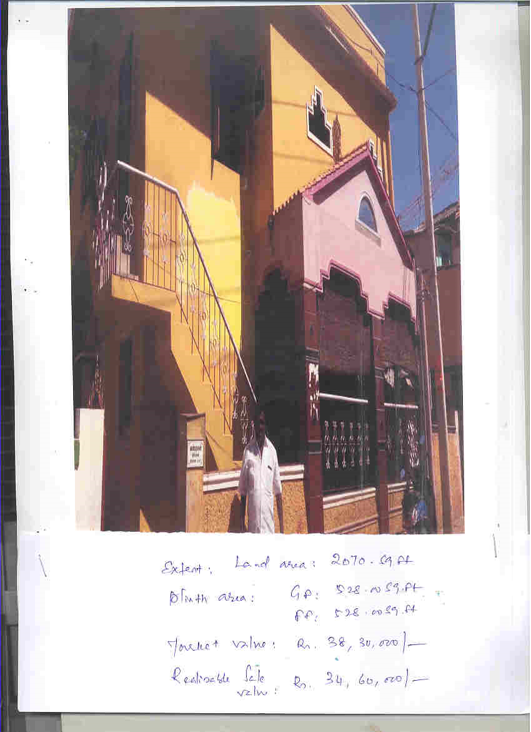
COMMERCIAL LAND & BUILDING
RESB-202
Location of Property | THIRUPPARAKUNDRAM,MADURAI
Total area of land | 2070.00 sq.ft
Constructed area | Ground Floor & First Floor (528.00 sq.ft each)
Year of construction | -----
Current market value | Rs. 38.30 Lacs

Slide 3
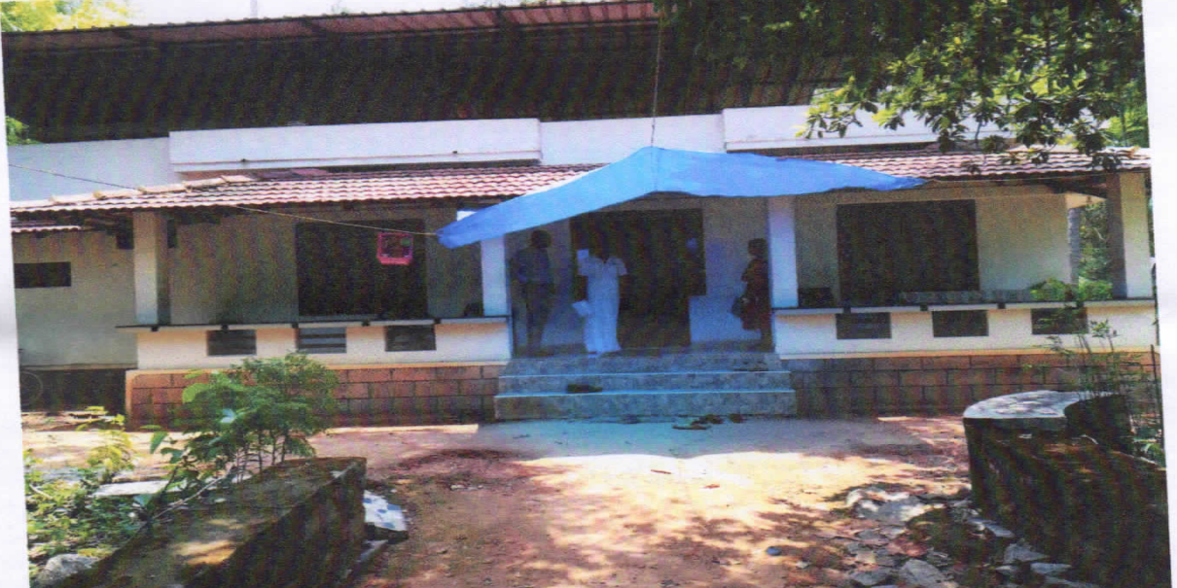
RESIDENTIAL BUILDING
RESB-203
Location of Property | VADAKARA,KOZHIKODE
Total area of land | 25.37 Cents
Constructed area | -----
Year of construction | -----
Current market value | Rs. 63.52 Lacs

Slide 4
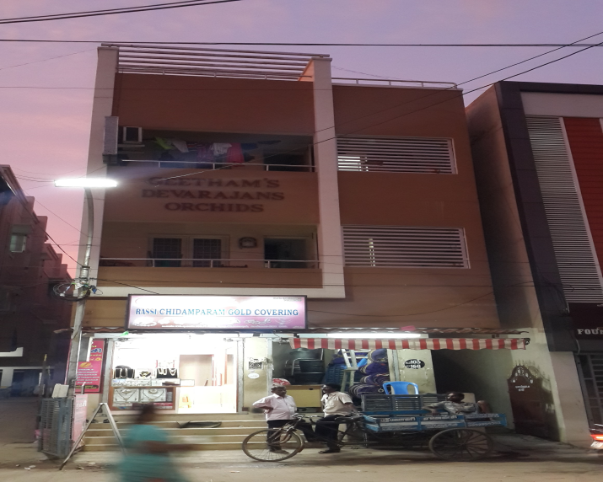
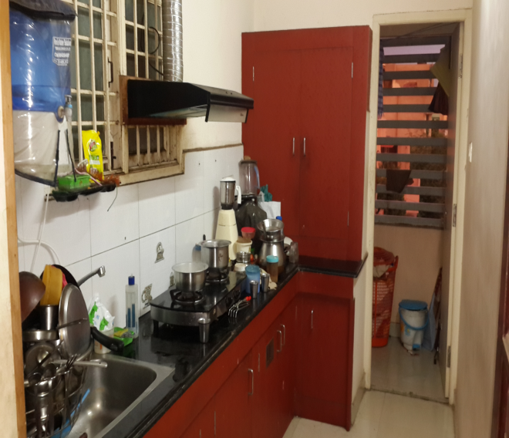
RESIDENTIAL BUILDING
RESB-204
Location of Property | AVADI ,CHENNAI
Total area of land | 1538.00 sq.ft
Constructed area | 1538.00 sq.ft
Year of construction | ----
Current market value | Rs. 65.62 Lacs

Slide 5
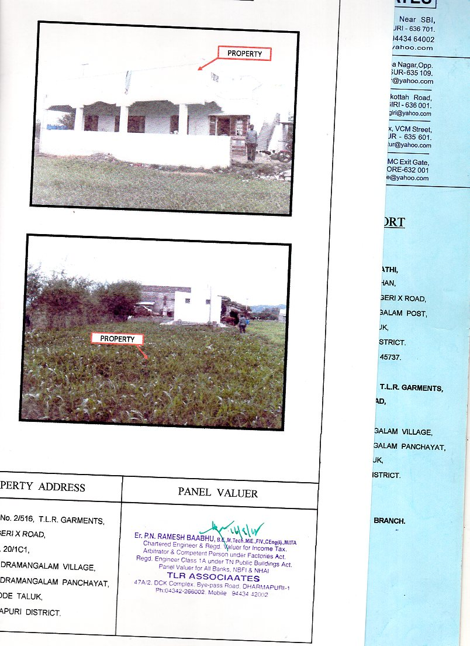
RESIDENTIAL LAND & BUILDING
RESB-205
Location of Property | KARIMANGALAM,DHARMAPURI
Total area of land | 7405 sq.ft
Constructed area | ---
Year of construction | 2014
Current market value | Rs. 27.65 Lacs

Slide 6
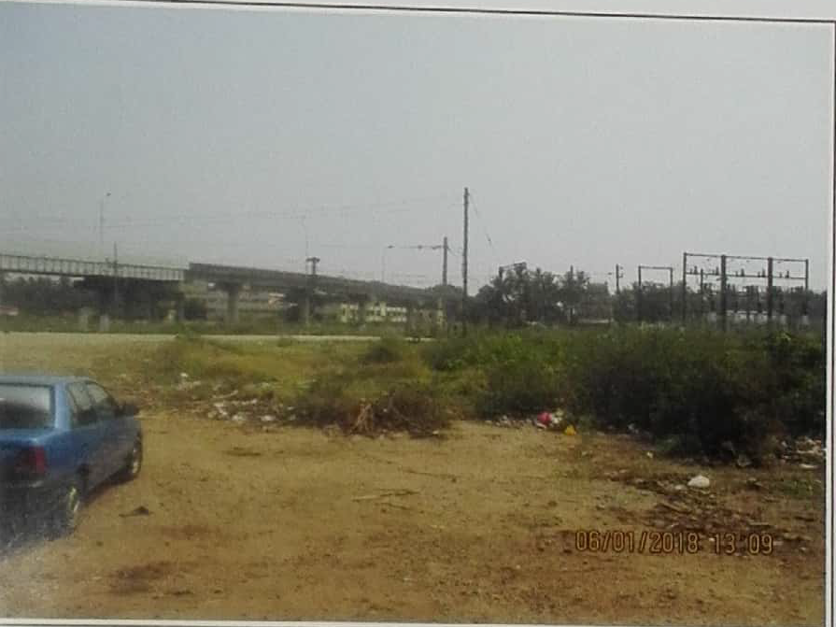
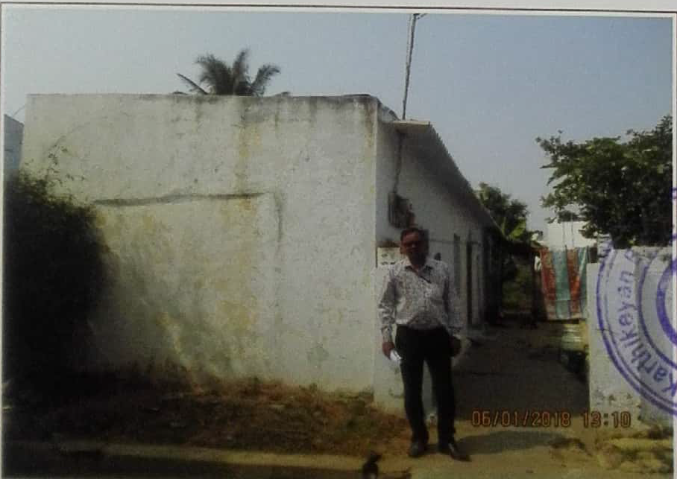
RESIDENTIAL LAND & BUILDING
RESB-206
Location of Property | COIMBATORE
Total area of land | 1975 sq.ft
Constructed area | NA
Year of construction | 2013
Current market value | Rs. 30.25 Lacs

Slide 7
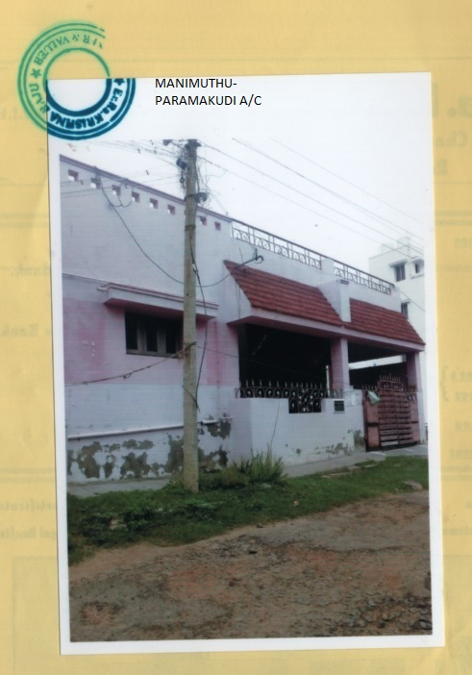
RESIDENTIAL LAND & BUILDING
RESB-207
Location of Property | KATTUPARAMAKUDI,RAMNAD
Total area of land | 1580 sq.ft
Constructed area | 1243 sq.ft
Year of construction | 2008
Current market value | Rs. 26.48 Lacs

Slide 8
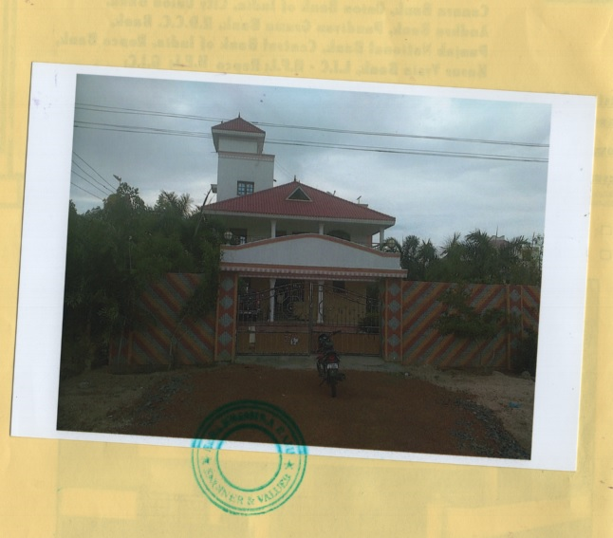
RESIDENTIAL LAND & BUILDING
RESB-208
Location of Property | SIVAGANGAI
Total area of land | 4525 sq.ft
Constructed area | GF-1855 sq.ft FF-1855 sq.ft
Year of construction | 2013
Current market value | Rs.59.07 Lacs

Slide 9
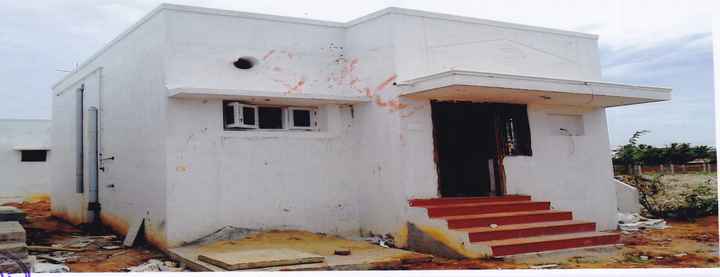
RESIDENTIAL LAND & BUILDING
RESB-209
Location of Property | AGRAHARAM SETHUR ,KARAIKAL
Total area of land | 1061 sq.ft
Constructed area | 516.31 sq.ft
Year of construction | 2015
Current market value | Rs. 11.10 Lacs

Slide 10
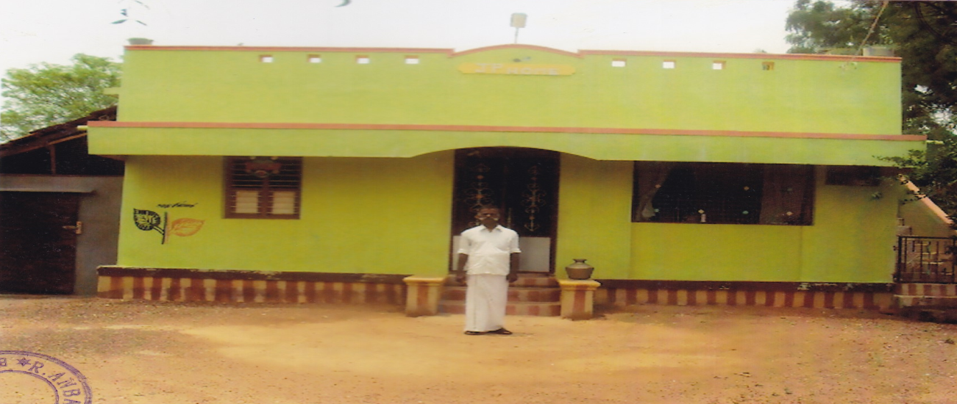
RESIDENTIAL LAND & BUILDING
RESB-210
Location of Property | PUDHUKILUVACHI
Total area of land | 16032 sq.ft
Constructed area | 481 sq.ft
Year of construction | 2009
Current market value | Rs. 22.00 Lacs

Slide 11
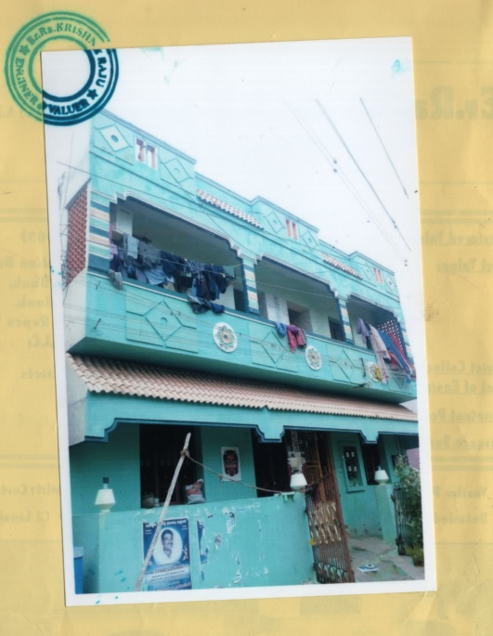
RESIDENTIAL LAND & BUILDING
RESB-211
Location of Property | AGRAHARAM SETHUR ,KARAIKAL
Total area of land | 7134 sq.ft
Constructed area | GF 1596 sq.ft FF 798 sq.ft
Year of construction | 2014
Current market value | Rs. 50.37 Lacs

Slide 12
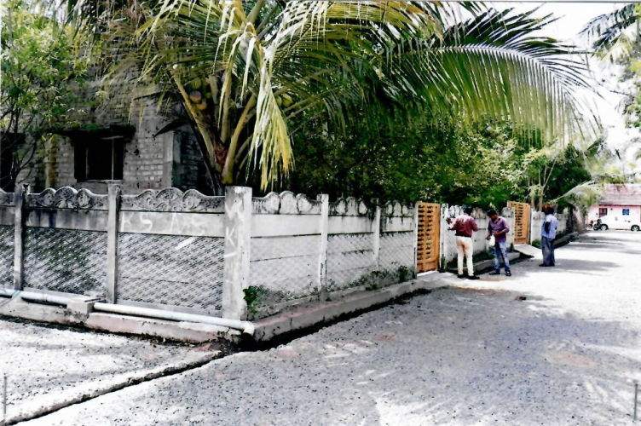
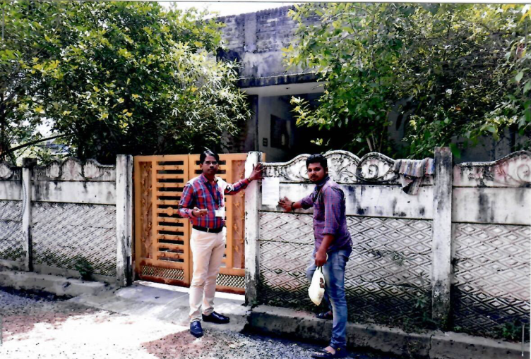
RESIDENTIAL LAND & BUILDING
RESB - 212
Location of Property | AGRAHARAM NAGRA,KARAIKAL
Total area of land | 7134 sq.ft
Constructed area | GF 1590 sq.ft FF 800sq.ft
Year of construction | 2014
Current market value | Rs.54.85 Lacs

Slide 13
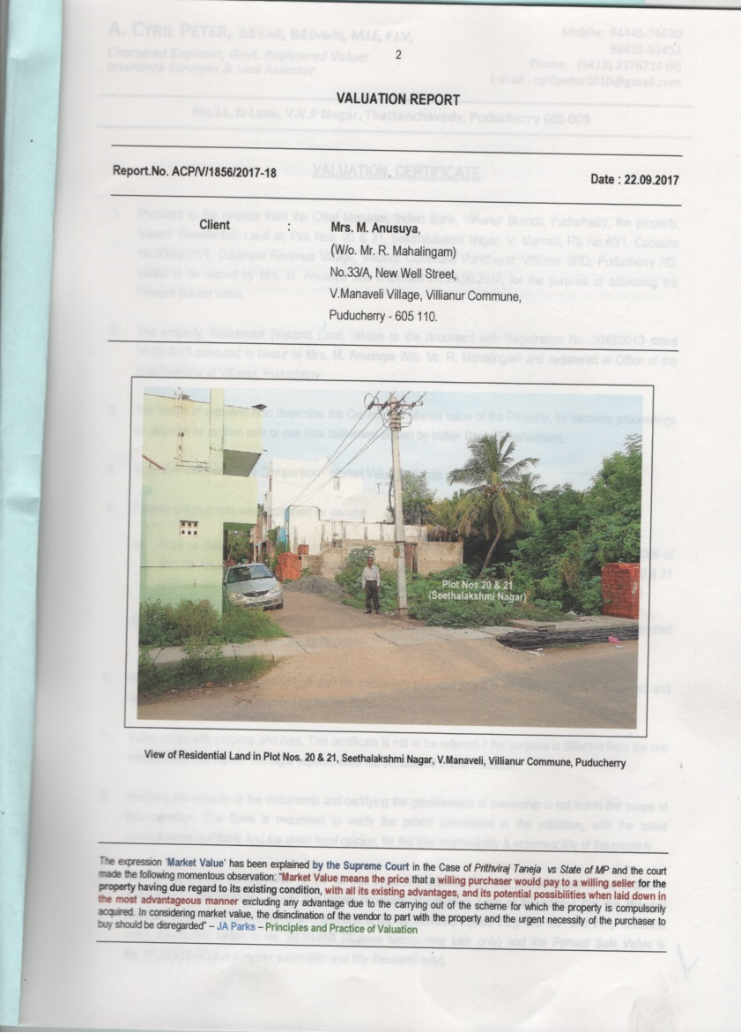
RESIDENTIAL LAND
RESB - 213
Location of Property | VILIANUR,PONDICHERRY
Total area of land | 2692 sq.ft
Constructed area | NA
Year of construction | NA
Current market value | Rs.32.00 Lacs

Slide 14
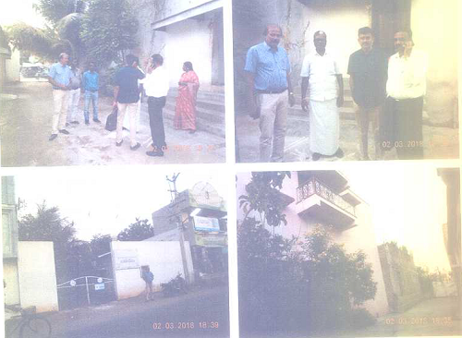
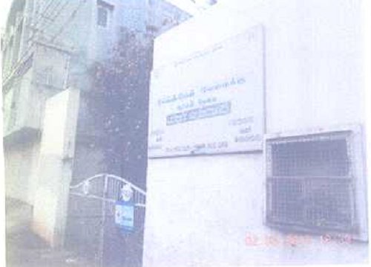
Residential Building
RESB - 214
Location of Property | Mr EP Jeyaram and JVR Food Products ARMB Madurai- Anayur- S Alangulam
Total area of land | 7302.25 sq ft
Constructed area | 3755 sq ft
Year of construction | 2002,2005 and 2010
Current market value | Rs 219.96 lakhs
Sale value | Rs 197.96 lakhs

Slide 15
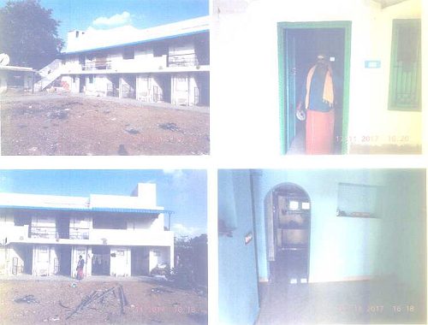
RESIDENTIAL BUILDING
N Kumarvel
RESB-215
Location of Property | Mr N Kumaravel ARMB- S n.61/1, MGR Nagar(Muthal Nagar), Rosalpatti village, Virudhunagar
Total area of land | 5550 sq.ft
Constructed area | 3120 sq ft
Year of construction | 2002(Ground Floor) & 2017(First floor)
Current market value | Rs 60.34 lakhs
Sale value | Rs 54.30 lakhs

Slide 16
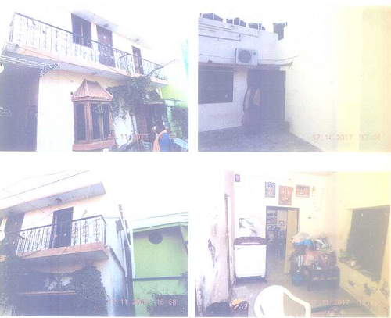
RESIDENTIAL BUILDING
N Kumarvel
RESB-216
Location of Property | Mr. N Kumaravel ARMB Door no.24, S Ward no.2, Katchehari Road, Nehruji Nagar, Virudhunagar
Total area of land | 876 sq.ft
Constructed area | 420 sq ft(Ground floor) 220 sq ft(First floor)
Year of construction | 1985&2016(Ground Floor) & 2016(First floor)
Current market value | Rs 23.89 lakhs
Sale value | Rs 21.50 lakhs

Slide 17
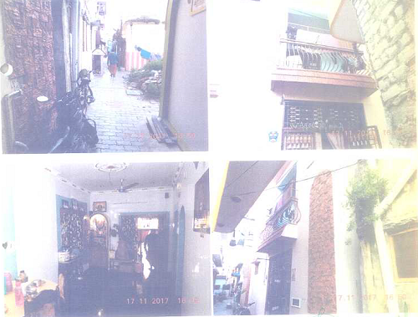
RESIDENTIAL BUILDING
N Kumarvel
RESB-217
Location of Property | Mr. N Kumaravel ARMB Door no.72,73&74, TS Ward no.4, Kuppaiah tevar lane, West car street,Virudhunagar
Total area of land | 624 sq.ft
Constructed area | 624 sq ft
Year of construction | 2007
Current market value | Rs 15.54 lakhs
Sale value | Rs 13.99 lakhs

Slide 18
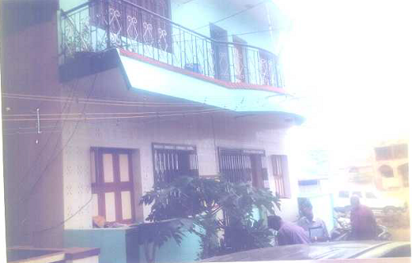
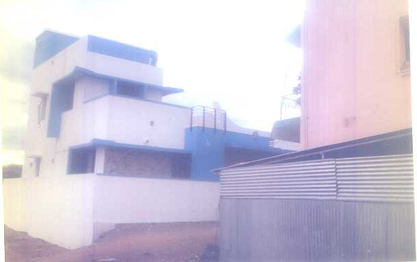
Residential Building
RESB-218
Location of Property | M/S The Praise Fine Arts. ARMB Sivakasi- Virudhunagar
Total area of land | 1396.50 sq ft
Constructed area | 110 sq m (GF)+21 sq m FF
Year of construction | 2007
Current market value | Rs 33.77 lakhs
Sale value | Rs 30.70 lakhs

Slide 19
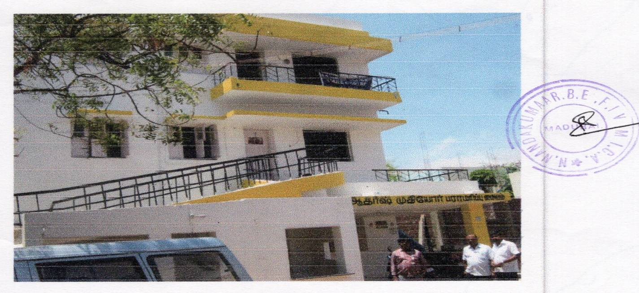
RESIDENTIAL BUILDING
RESB-219
Location of Property | Mrs Nalini Bibikulam Madurai Ponmeni
Total area of land | 1936 sq.ft
Constructed area | 1936 sq ft+1936 sq ft+1936 sq ft (GF+FF+SF)
Year of construction | 2002
Current market value | Rs. 155.35lacs
Sale value | Rs. 133.73lacs

Slide 20
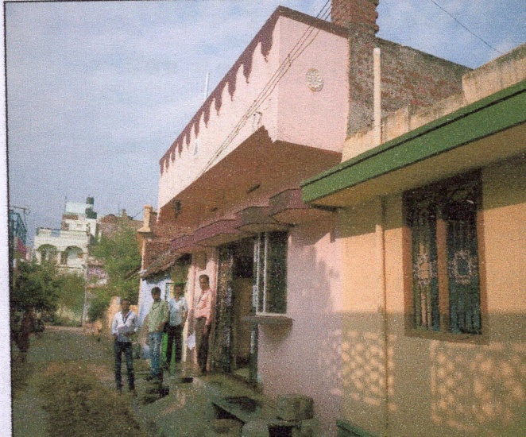
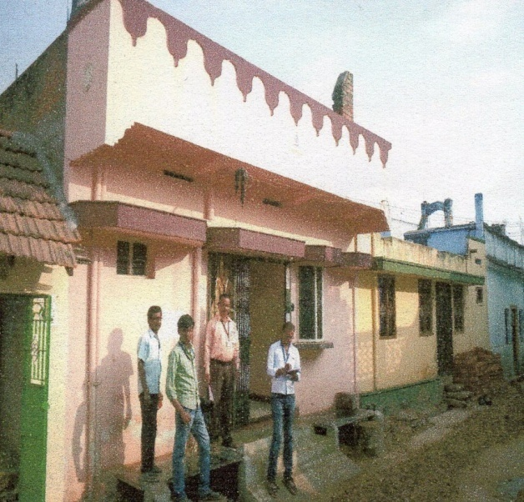
RESIDENTIAL BUILDING
RESB-220
Borrower Name | N Asha Devi W/O V Karthikeyan
Location of Property | Bodinayakanur, Theni Dist.
Total area of land | 1465 Sq.Ft.
Constructed area | Residential Building
Current market value | Rs. 29.78 lakhs
Sale value | Rs. 25.31 lakhs

Slide 21
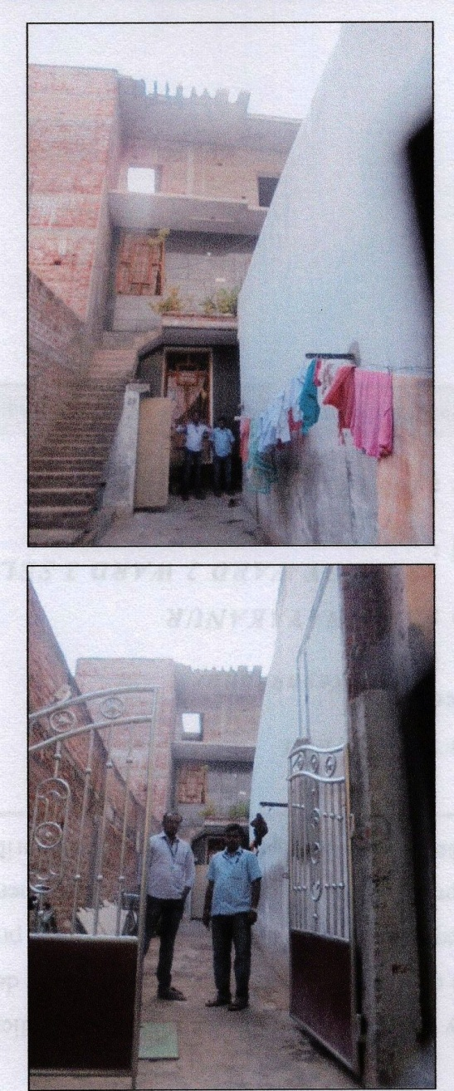
RESIDENTIAL HOUSE
RESB-221
Borrower Name | Mr.A.Dharmar
Location of Property | Bodinayakanur, Theni Dt
Constructed area | 1546 Sq.Ft
Floor | Ground, First & Second Floor
Current market value | Rs. 46.22 lakhs

Slide 22
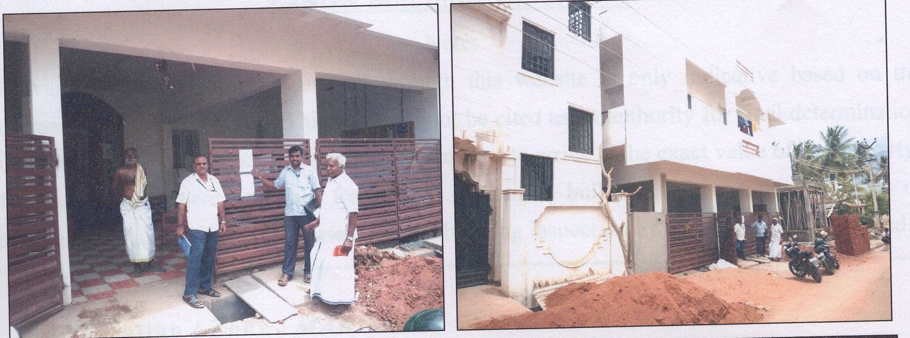
RESIDENTIAL HOUSE
RESB-222
Borrower Name | M/s RVT Traders
Location of Property | Bodinayakanur, Theni Dist
Total area of land
Constructed Area | 2460 Sq.Ft
Current market value | Rs. 66.06 lakhs
Sale value | Rs. 56.15 lakhs

Slide 23
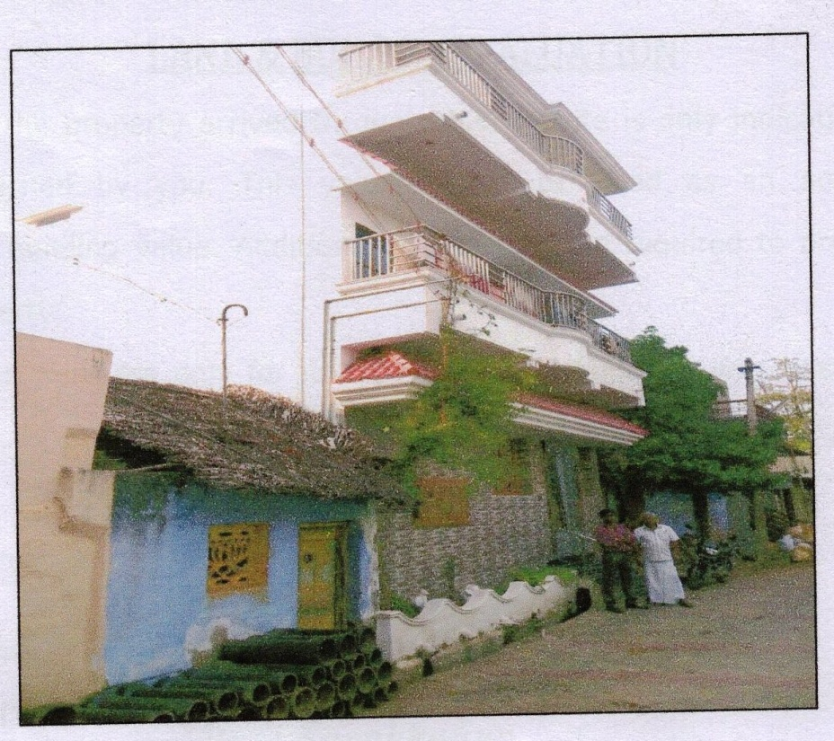
RESIDENTIAL HOUSE
RESB-223
Borrower Name | Mr.Thangappa & Raja Mohammed
Location of Property | Bodinayakanur, Theni Dist
Total area of land | 804 Sq.ft
constructed Area | Ground, 1st & 2nd Floor
Current market value | Rs. 47.23 lakhs
Sale value | Rs. 37.78 lakhs

Slide 24
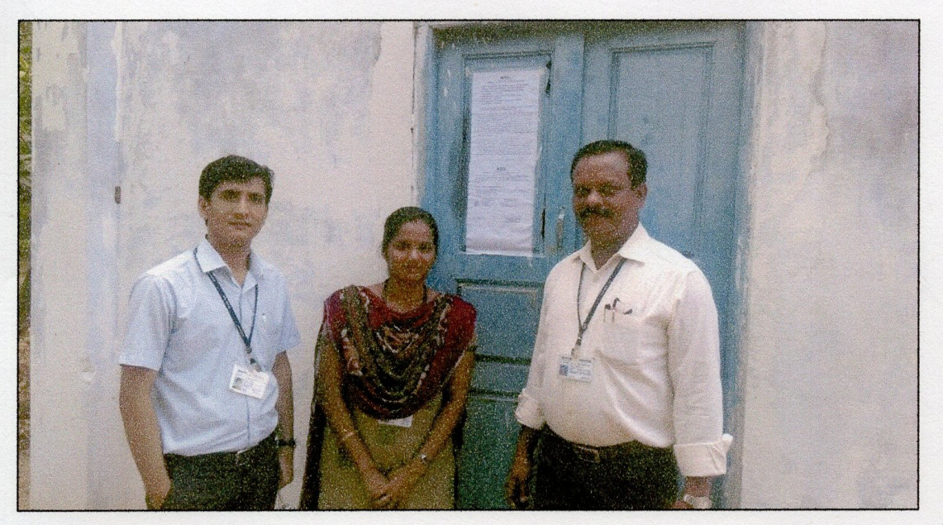
MANGO ORCHARD – AGRI LAND
RESB-224
Borrower Name | S UMA MAHESWARI
Location of Property | BODINAYAKANUR, Theni Dist.
Total area of land | 5.30 Acres
Constructed area | 120 Sq.ft (Motor Room)
Current market value | Rs. 29.15 lakhs
Sale value | Rs. 21.86 lakhs

Slide 25
RESIDENTIAL BUILDING
RESB- 225
Location of Property | MainMr Mahaboobjohn Madurai Palamedu, Madurai Dist
Total area of land | 3627 Sq.Ft
Constructed area | Ground Floor 891 Sq.Ft, 1st Floor 666 Sq.Ft
Year of construction | 2010
Current market value | Rs. 78.43 Lakhs
Sale value | Rs. 70.58 Lakhs

Slide 26
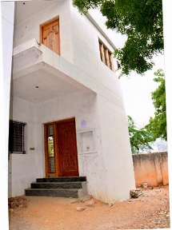
RESIDENTIAL BUILDING
RESB - 226
Location of Property | Mr A Rajasekaran Byepass Road Branch Madurai ,Thirupparankundram
Total area of land | 703 sq ft
Constructed area | GF 447 Sq ft FF 447 Sq ft
Year of construction | 2012
Current market value | Rs 20.74 lakhs
Sale value | Rs 18.66 lakhs

Slide 27
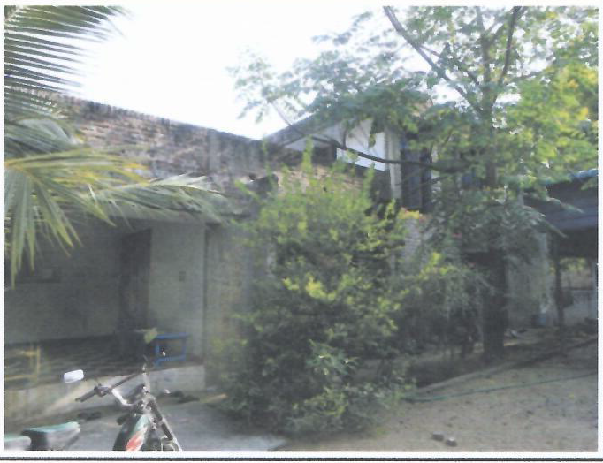
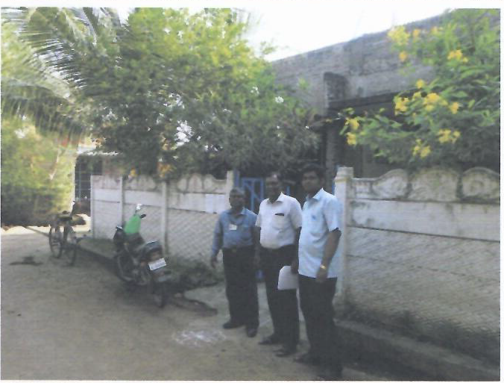
RESIDENTIAL LAND & BUILDING
RESB- 227
Location of Property | AGRAHARAM SETHUR ,KARAIKAL
Total area of land | 7134 sq.ft
Constructed area | GF 1596 sq.ft FF 798 sq.ft
Year of construction | 2014
Current market value | Rs. 63.08 Lacs

Slide 28
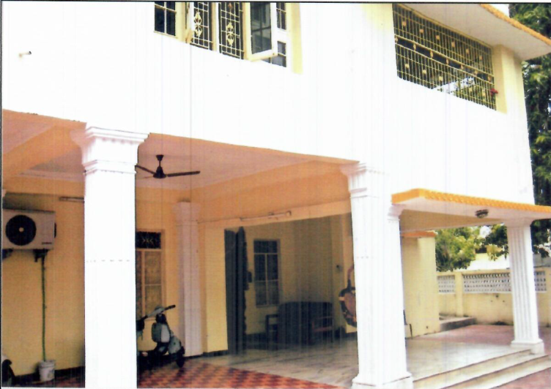
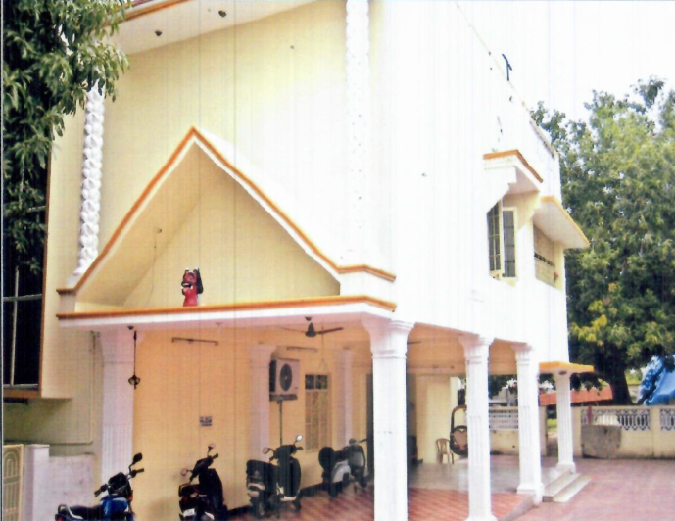
RESIDENTIAL LAND & BUILDING
RESB - 228
Location of Property | KOTTUCHERRY,KARAIKAL
Total area of land | 3140 sq.ft
Constructed area | GF 278 sq.mtr FF 257 sq.mtr
Year of construction | BUILDING 1986 OFFICE &STORE 1995
Current market value | Rs.353.00Lacs

Slide 29
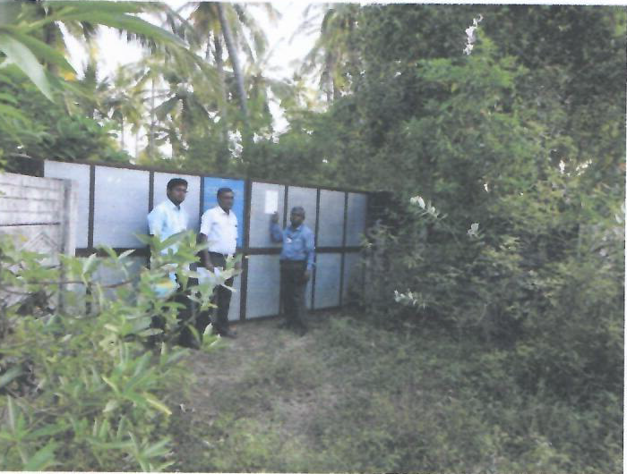
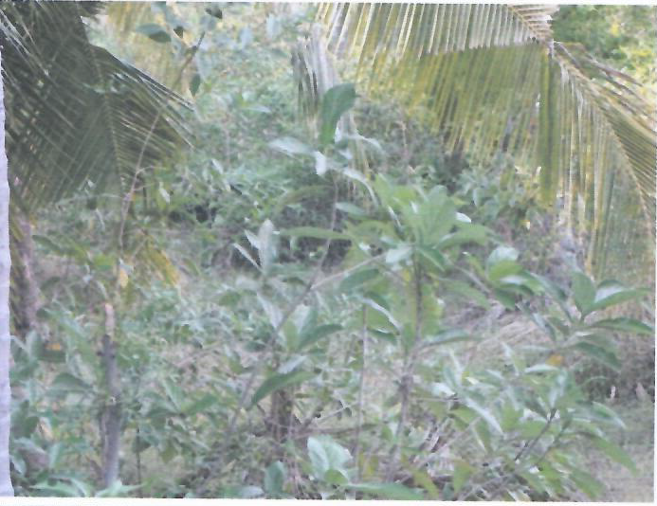
RESIDENTIAL LAND & BUILDING
RESB - 229
Location of Property | NANILLAM,TIRUVARUR
Total area of land | 14533 sq.ft
Constructed area | GF 1960 sq.ft FF 524 sq.ft
Year of construction | 2017
Current market value | Rs.53.97 Lacs

